Slide 1

NEIL GOGTE INSTITUTE OF TECHNOLOGY
Machine Learning Case Study
GENDER CLASSIFICATION
BY
Name :GUNTI SAI PRANITHA Roll Number:245322733148
Name :KANCHU NAVYATEJA Roll Number:245322733154
Name :GVR VINEELA Roll Number:245322733143

Slide 2

INTRODUCTION
OBJECTIVE
Classify gender (Male/Female) from facial images using a Convolutional Neural Network (CNN).
Why this project:
Gender classification is helpful in many areas. For example, it can show better ads based on gender, help in watching and understanding people in public places (like in cameras), and make security systems more personalized and safer.
DataSet Used:
UTKFace: A Large-Scale Face Dataset for Age, Gender, and Ethnicity Prediction

Slide 3
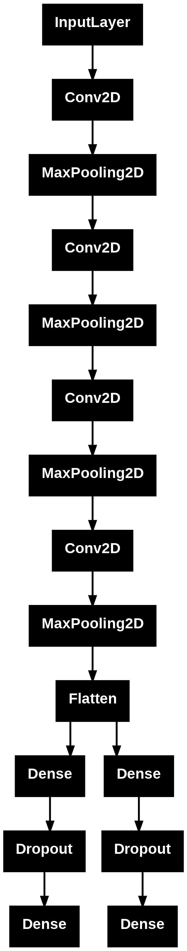
Proposed Architecture

Slide 4
Packages/ Algorithms Used
Libraries:
TensorFlow / Keras
NumPy
OpenCV / Matplotlib
Sklearn
Algorithms/Concepts:
Convolutional Neural Network (CNN)
Image preprocessing (resizing, normalization)
Binary classification with relu activation
Adam optimizer and binary crossentropy loss

Slide 5
Execution Link
GOOGLE COLAB:
https://colab.research.google.com/drive/1fc9TNUDV8_9tePr7CK-u_hSS_xzUqBQT?usp=sharing

Slide 6
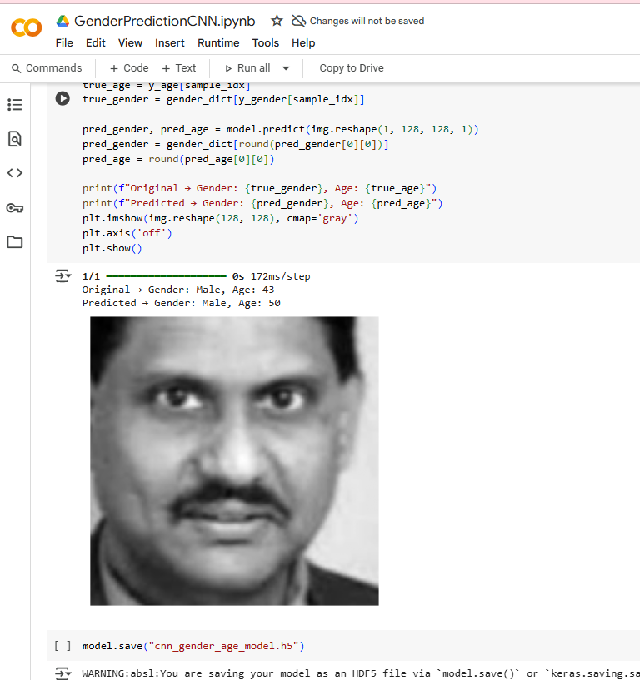
Output Screenshots (e.g matrix or plots)

Slide 7
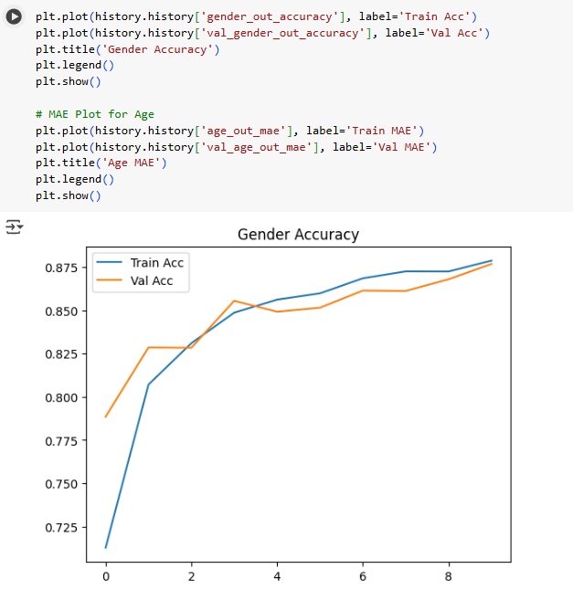
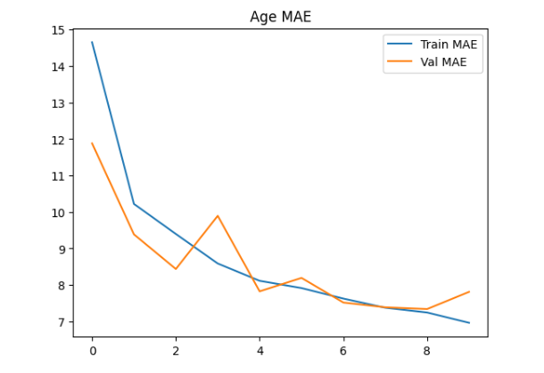
Output Screenshots (e.g matrix or plots)

Slide 8
Advantages/ Disadvantages
Advantages:
Automates gender classification with high accuracy
Learns facial features without manual intervention
Reusable and scalable for large datasets
Disadvantages:
May suffer from bias if dataset is imbalanced
Accuracy can drop for poor-quality images
Cannot handle non-binary gender representations

Slide 9
Use of Project
In marketing to understand user demographics
In security systems for personalized authentication
In analytics for gathering user insights
In human-computer interaction to adapt responses

Slide 10
Conclusion
In this project, we built a CNN model to classify gender from face images.
The model learned to identify important facial features and was able to predict whether a person is male or female with good accuracy.
We understood how CNNs work for image classification and how to handle image data. In the future, we can improve the model using better datasets, data augmentation, or advanced pre-trained models.
Overall, the project shows how deep learning can solve real-life problems like gender classification.

Slide 11
Questions ??

Slide 12


